Slide 1
Lecture 3 (online) Black-box Testing Techniques
Naseem us Sehar

Slide 2
Boundary Value Analysis
In the last lecture we have covered Equivalence Class Partitioning
Equivalence Class Partitioning and Boundary Value Analysis are test case design techniques.
input values at the extreme ends of the input domain cause more errors in the system
More application errors occur at the boundaries of the input domain.
BVA applies the boundary restrictions on Equivalence classes.
Boundary Value Analysis is the next part of Equivalence Partitioning for designing test cases where test cases are selected at the edges of the equivalence classes.

Slide 3
Example
Test cases for input box accepting numbers between 1 and 1000 using Boundary value analysis:
#1) Test cases with test data exactly as the input boundaries of input domain i.e., values 1 and 1000 in our case.
#2) Test data with values just below the extreme edges of input domains i.e., values 0 and 999.
#3) Test data with values just above the extreme edges of the input domain i.e., values 2 and 1001.

Slide 4
Pros & Cons
Pros
It is easier and faster to find defects using this technique. This is because the density of defects at boundaries is more.
Instead of testing will all set of test data, we only pick the one at the boundaries. So, the overall test execution time reduces results in cost reduction.
Cons
This system once in a while neglects to test all the potential input values. Thus, the outcomes are uncertain.
This procedure doesn’t fit well with regards to Boolean Variables.

Slide 5
Cause-and-effect Graph
The Cause-and-Effect Graph is a dynamic test case writing technique. Here causes are the input conditions and effects are the results of those input conditions.
Cause-Effect Graph is a technique that starts with a set of requirements and determines the minimum possible test cases for maximum test coverage which reduces test execution time and cost.
The goal is to reduce the total number of test cases, still achieving the desired application quality by covering the necessary test cases for maximum coverage.

Slide 6
Cause-and-effect Graph / Decision Table
The Cause-Effect Graph technique restates the requirements specification in terms of the logical relationship between the input and output conditions. Since it is logical, it is obvious to use Boolean operators like AND, OR and NOT.

Slide 7
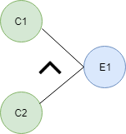
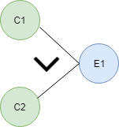
Notations Used in Cause-and-Effect Graph
AND - E1 is an effect and C1 and C2 are the causes. If both C1 and C2 are true, then effect E1 will be true.
OR - If any cause from C1 and C2 is true, then effect E1 will be true.

Slide 8
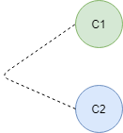

Notations Used in Cause-and-Effect Graph
NOT - If cause C1 is false, then effect E1 will be true.
Mutually Exclusive - When only one cause is true.

Slide 9
Example
Situation:
The “Print message” is software that reads two characters and, depending on their values, messages is printed.
The first character must be an “A” or a “B”.
The second character must be a digit.
If the first character is an “A” or “B” and the second character is a digit, then the file must be updated.
If the first character is incorrect (not an “A” or “B”), the message X must be printed.
If the second character is incorrect (not a digit), the message Y must be printed.

Slide 10
Example
The Causes of this situation are: C1 – First character is A C2 – First character is B C3 – the Second character is a digit
The Effects (results) for this situation are: E1 – Update the file E2 – Print message “X” E3 – Print message “Y”

Slide 11
In this example, let’s start with Effect E1.
Effect E1 is for updating the file. The file is updated when – The first character is “A” and the second character is a digit – The first character is “B” and the second character is a digit – The first character can either be “A” or “B” and cannot be both.
Now let’s put these 3 points in symbolic form:
For E1 to be true – the following are the causes: – C1 and C3 should be true – C2 and C3 should be true – C1 and C2 cannot be true together. This means C1 and C2 are mutually exclusive.

Slide 12
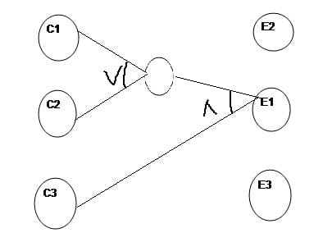
Draw the cause-and-effect graph

Slide 13
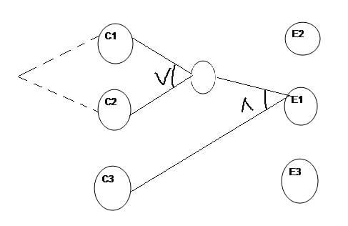
As we know C1 and C2 are mutually exclusive

Slide 14
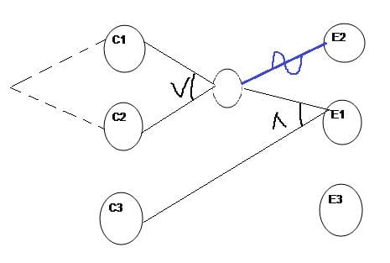
Now we will see how E2 is generated

Slide 15
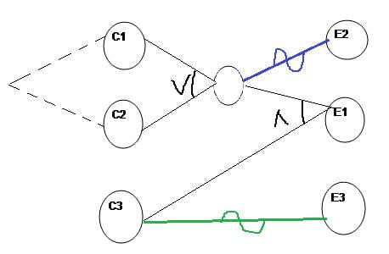
E3 is generated as

Slide 16

Decision Table
Now for E1 to be “1” (true)

Slide 17
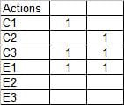
Decision Table
we have the below two conditions – C1 AND C3 will be true C2 AND C3 will be true

Slide 18
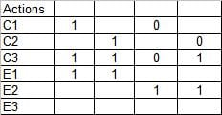
Decision Table
For E2 to be True, either C1 or C2 has to be False shown as,

Slide 19
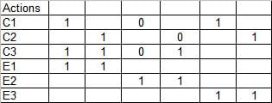
Decision Table
For E3 to be true, C3 should be false. But C1 or C2 can be true

Slide 20
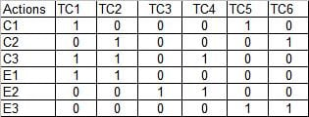
Decision Table
Finally fill the rest of table cells with 0

Slide 21
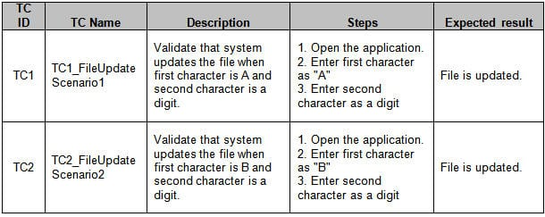
Test Case Sample

Slide 22
Thank You!

